Slide 1
Reforming Property Taxes in Oregon
A proposal to adopt land value taxation
Prepared by
Tom Gihring & Kris Nelson
Common Ground OR-WA

Slide 2
Land Value Taxation Objectives
> Encourage private capital investment > Discourage speculative landholding
Expected Land Use Benefits
Bring idle land into production
Intensify land development
Discourage building deterioration
Encourage infill
Discourage sprawl
Restrain residential lot prices

Slide 3
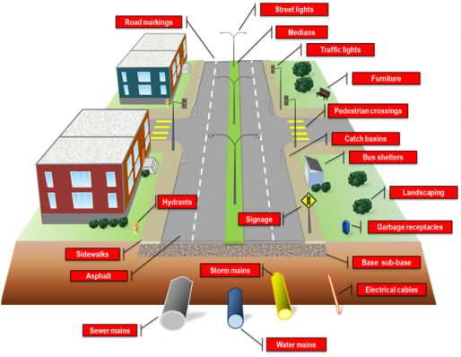
Economic Principles of Land Value Taxation
Land value belongs to the community
Building value belongs to the owner
Land Value
Represents the presence of…
- Public infrastructure
- Public facilities & services
- Area amenities & desirability
- Accessibility
Building & Improvement Value
- Represents owners capital investment
Socially- created value
Privately-created
value
VS

Slide 4
Principle of Progressive Taxation
A tax tends to diminish its tax base
What is in the public interest should be taxed less
What is not desirable should be taxed more
Job Growth
Capital investment
Land/Resource Consumption

Slide 5
The current property tax system does
just the opposite!
Taxing Capital investment more
&
Land/Resource consumption less
The Results?
Urban Sprawl
• Devouring valuable resource lands
• Creating high household transportation costs
Land Price Inflation
• Incentivizing rent-seeking, i.e. land speculation and windfalls
• Driving up housing prices

Slide 6
Why is Orgon’s tax system so regressive?
Oregon’s attempt to limit property taxes in 1993 resulted in unintended consequences:
M-50 replaced RMV with MAV
Gradually shifting tax burden onto lower value residential sites
Equal Rate Taxation
De-coupling real market value and assessed value has resulted in significant inequities in property tax bills between taxpayers
By taxing land and improvement values at the same rate, the bulk of a jurisdiction’s tax falls on buildings. The tax falls lightly on land-consuming uses – vacant and underutilized sites.
Discouraging owners to invest in property improvements
Increasing disparity between market & taxable values * Unequal treatment of taxpayers * Continuous revenue shortfalls

Slide 7
Land Value Taxation
LVT taxes land at a higher rate
LVT taxes improvements at a lower rate
The equal rate tax is replaced by a two-rate tax

Slide 8
COMPARISON OF TWO
PROPERTY TAX SYSTEMS
Method of Calculating Tax Bills for Individual Properties
Conventional Uniform Ad Valorem Tax
Total Value
Tax
Rate
Tax Bill
Two-rate Land Value Property Tax
Bldg. Value
Bldg.Tax
Rate
Land Value
Land Tax
Rate
Tax Bill

Slide 9
The two-rate LVT Ratio is expressed as the percentage of the total tax rate applied to land assessments
Example of an LVT tax rate structure during a phase-in period
Phase-in Year | Total Tax Rate | LVT Ratio | Land Tax Rate | Building Tax Rate
Year 1 | 21.00 | 55% | 24.03 | 19.66
Year 2 | (mill rate) | 60% | 27.14 | 18.09
Year 3 |  | 65% | 30.48 | 16.41
Year 4 |  | 70% | 34.10 | 14.61
Year 5 |  | 75% | 38.01 | 12.67
• Local option
• Uniform application of tax rates
• Revenue neutral in first year
Proposed features of model LVT legislation::

Slide 10
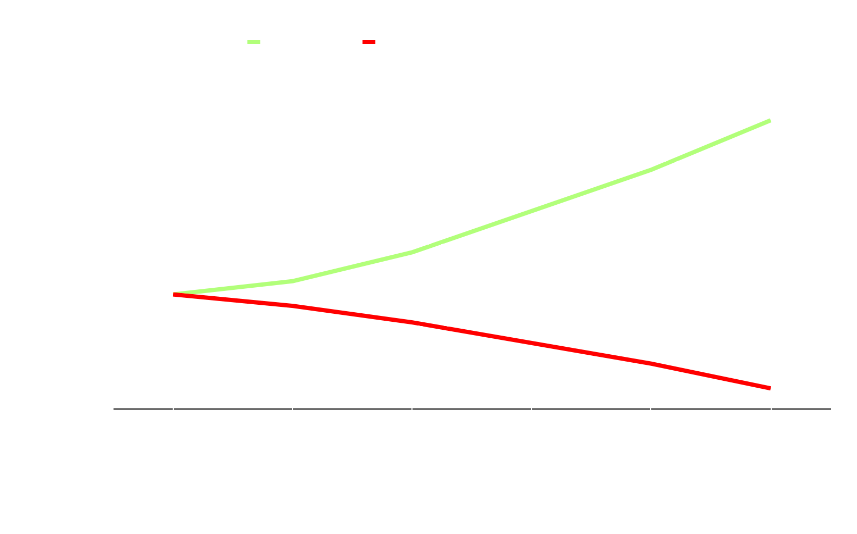
Why Can’t Measure 5 limitations coexist with LVT?
M-5 limits tax rates to $5 per
$1,000 RMV for school taxes and $10 per $1,000 RMV for general government.
When the building tax rate is reduced, the land tax rate must rise to achieve revenue neutrality.
Two-Rate
Property Tax
Conventional
Property Tax
Land Tax
Rate
26.76
Example
Total Tax Rate
13.89
Bldg. Tax
Rate
This rate exceeds M-5 limits.
8.92

Slide 11
Consider Salem City parcels following 6 years of Equal rate MAV assessments:
A simulation model comparison:
Compared to a revenue neutral tax reverting to RMV assessments…
Taxes on…
Multifamily apartments increase by 11.8%
Retail stores & offices increase by 5.0%
Downtown surface parking lots decrease by 4.2%
Downtown vacant lots decrease by 16.1%
These effects created negative incentives and countravened the objectives of Oregon’s Urban Growth Management Act.

Slide 12
Now, see the tax shift effects of a change back to RMV assessments with a Land Value Tax*
LVT taxes on Salem…
*75% LVT Ratio, 1998 tax year
Multifamily apartments decrease by 28.0%
Retail stores & offices decrease by 5.0%
Downtown surface parking lots increase by 92.0%
Downtown vacant lots increase by 104.6%
…compared to a revenue neutral equal rate MAV tax.
The LVT effects are a reversal of incentives, now discouraging land holding and encouraging building investment.

Slide 13
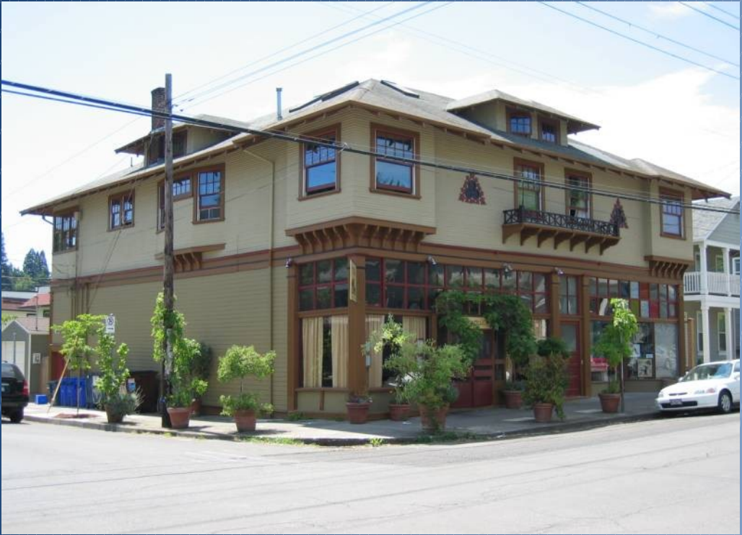
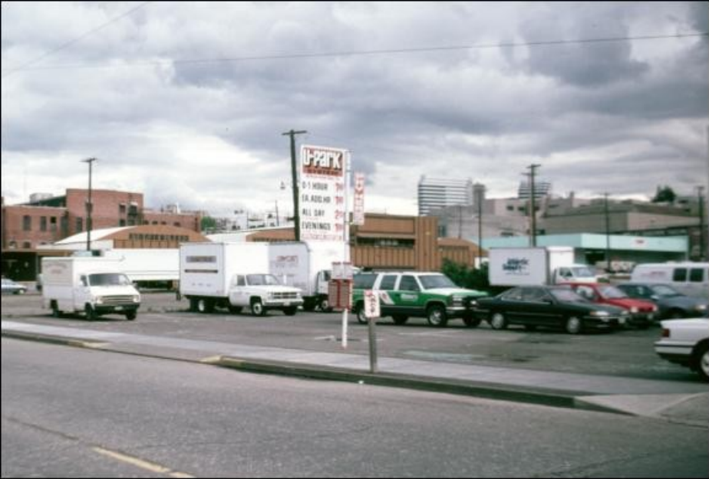
LVT incentivizes building investment
Generally…
Building-intensive uses will experience a decreased tax burden
Land-intensive uses will experience an increased tax burden
Low L-T-V Ratio
High L-T-V Ratio

Slide 14
Illustration Of Tax Incentive Effects:
Inner Northeast Portland
where MAV assessments lag far behind RMV assessments.
MAV:RMV Ratio
= 29%
The following slide pairs consist of photos of selected properties, and the tax shift effects when changing…
from MAV -- to equal rate RMV -- to LVT
Tax year 2018 Northwest Economic Research Center, Land Value Tax Analysis: Simulating the Effects in Multnomah County, June 2019

Slide 15
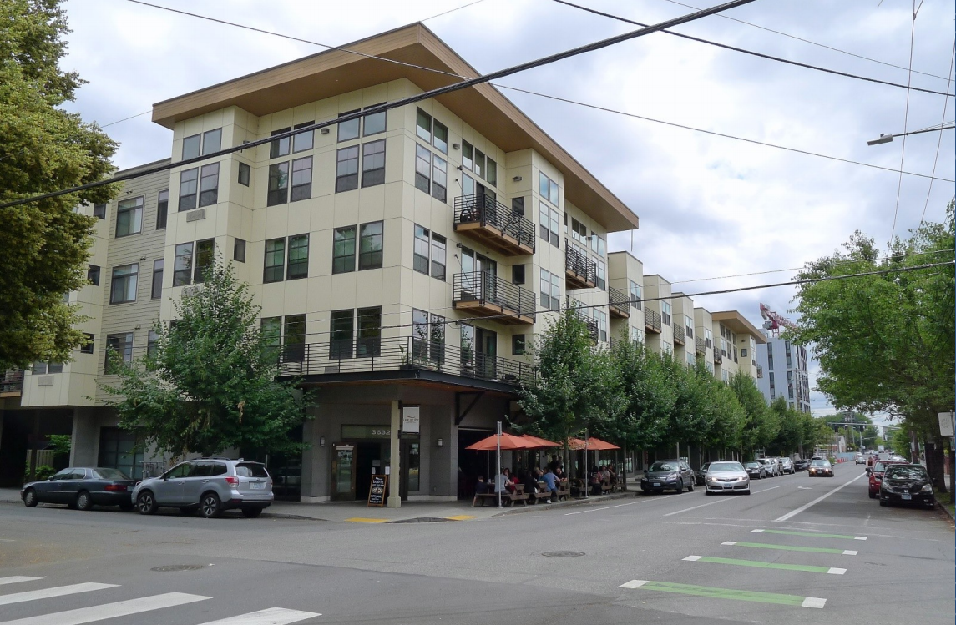
Year built: 2011 Multifamily Mid-Rise

Slide 16
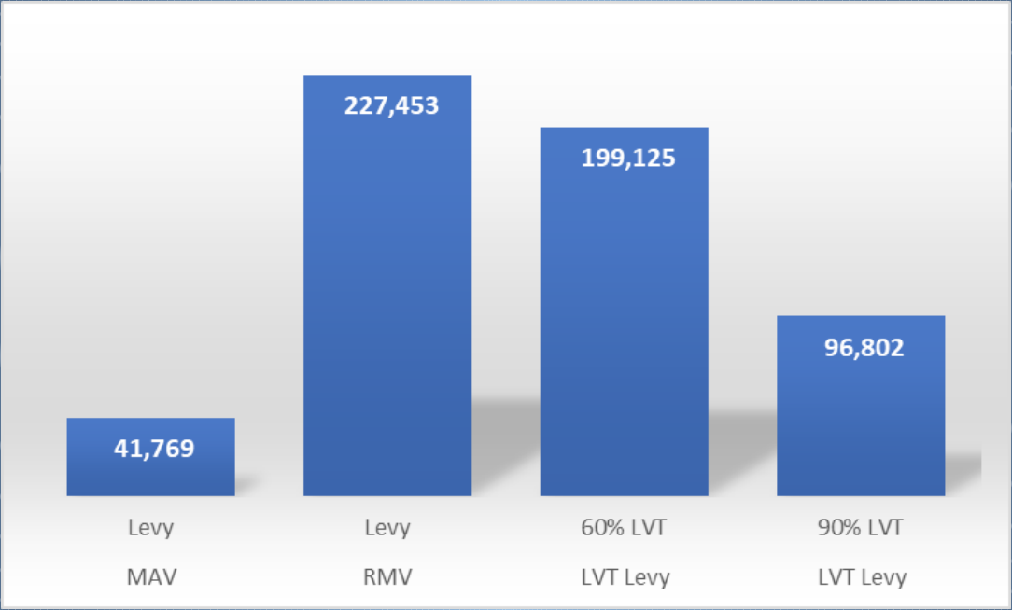
TAX SHIFT
MAV – RMV – 60% LVT – 90% LVT
Multifamily Mid-Rise
Year built: 2011
Real Market Value
Land = $2,052,670 Improv. = $19,346,290 L-T-V Ratio: .10

Slide 17
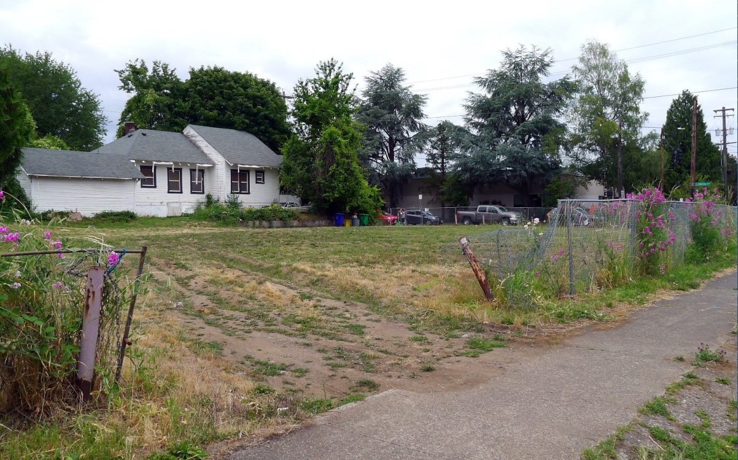
Vacant Lot

Slide 18
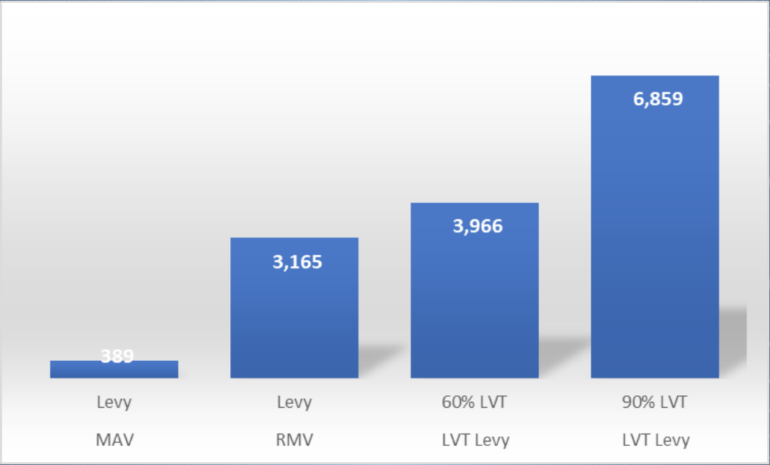
TAX SHIFT
MAV – RMV – 60% LVT – 90% LVT
Vacant Lot
Real Market Value
Land = $297,770 Improv. = $0
L-T-V Ratio: 1

Slide 19
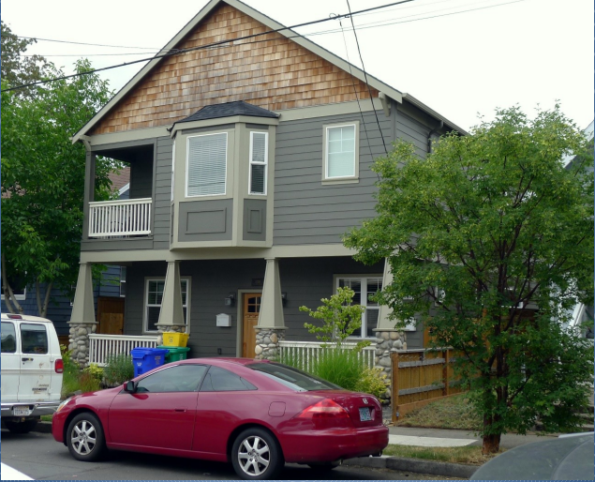
Year built: 2017 Single Family Infill

Slide 20
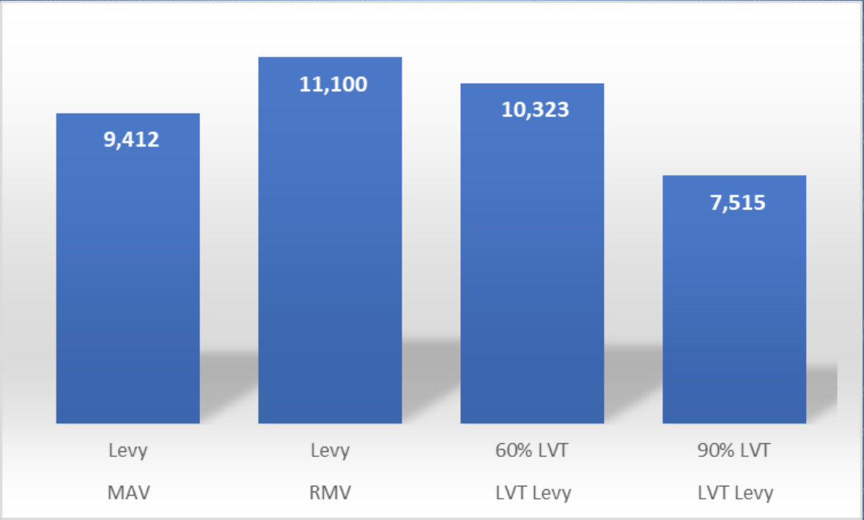
TAX SHIFT
MAV – RMV – 60% LVT – 90% LVT
Single Family Infill
Year built: 2017
Real Market Value
Land = $236,500 Improv. = $807,860 L-T-V Ratio: .23

Slide 21
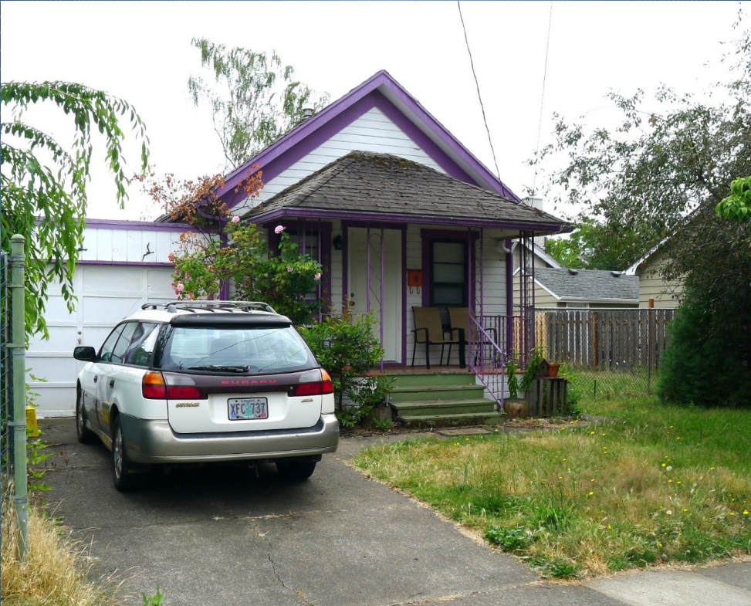
Year built: 1922 Low Value Single Family

Slide 22
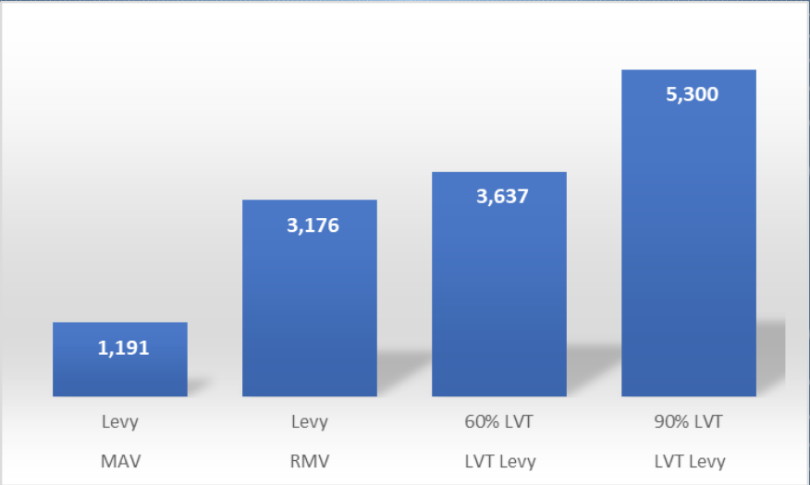
TAX SHIFT
MAV – RMV – 60% LVT – 90% LVT
Single Family
Year built: 1922
Real Market Value
Land = $221,500 Improv. = $77,370 L-T-V Ratio: .74

Slide 23
Oregon Governor’s Task Force Recommends LVT
The Housing Production Advisory Council is responsible for proposing an action plan to meet the state's housing production goals
Recommendations of the council’s Consolidated Tax Reform Work Group:
Adopt a Land Value Tax
“Oregon’s property tax system disincentivizes improvements to real property; eliminating the disincentive will lead to the creation of more housing units.”
“This tax is especially well suited to Oregon where our land use system further constrains the supply of urbanizable land.”
“We recommend that the legislature draft the referrals for an amendment to the Constitution followed by several statutory changes.”

Slide 24
Are there other U.S. jurisdictions that switched to LVT?
PENNSYLVANIA
allows cities to adopt a split-rate LVT.
Pittsburgh first adopted the split-rate in 1913. Its tax structure has been studied for more than a century. Building construction there leapt ahead of other Rust Belt cities. Taxing land at a rate five times higher than on buildings compelled the owners of vacant sites to construct buildings and to move up the timing of construction. The land tax structure had a significant role in spurring commercial investment in downtown Pittsburgh.
Harrisburg, once one of the most distressed cities in the nation. Since LVT was introduced in 1975 the annual land value tax on all taxable land their city has jumped from bottom to the top group of American cities. Mayor Reed says: “Without hesitation we can commend the importance and benefit of the land value tax policy. It has worked in Harrisburg and in other communities where it has existed.”
Subsequently, 5,200 vacant properties were restored, and taxable businesses rose from 1,908 to 5,900. A number of smaller Pennsylvania towns adopting LVT also saw dramatic increases in building permits issued.

Slide 25
MICHIGAN
Economists are buzzing with interest in LVT, and Detroit’s mayor, Mike Duggan, is all in. Spearheading the effort, he hopes this reform will incentivize development on blighted property, as taxes increase on vacant land and decrease for those who develop their land. The Duggan administration still hopes to implement the land-value tax in 2025. (August 2023)
Leading economists – including 4 Nobel Laureates - agree Detroit’s proposed land tax reform would give a "substantial boost" to the city's economic growth.
COLORADO
Gov. Jared Polis of Colorado is pushing the Commission on Property Tax to study potential adoption of LVT: “Taxing land — not the buildings on top of it — has the benefit of reducing land speculation and promoting environmentally sound development; in contrast, taxing buildings discourages investing in your home.” (January 2024)

Slide 26
Key Provisions of a Resolution Authorizing a Local-Option Land Value Tax
A city or county may adopt the LVT alternative
Land & Improvements are taxed at differential rates
LVT is exempt from Measures 5 & 50 limitations
RMV assessments are restored, replacing MAV
Amendment is subject to statewide voter approval

Slide 27
The Study bill examines the feasibility of LVT
The Legislative Revenue Office will conduct a study of LVT, to include:
Examination of tax burden effects changing from taxation under Measures 5 & 50 to taxation under LVT.
Simulation model comparisons using MAV and revenue neutral RMV assessments.
Examine comparative economic incentive effects in urban and rural jurisdictions.
Examine incentive effects in jurisdictions utilizing rural enterprise zones.
Examine possible tax burden relief measures for hardship cases.

Slide 28
Is there a better way to place a limit on taxes?
“Evidence shows that limits on assessed values are a deeply flawed means to counter rising property taxes.”
They create horizontal inequities. Homes of equal value and characteristics can have vastly different property tax burdens.
Owners of older property benefit from low tax payments while occupying their homes, and they gain capital bonuses once they sell their homes.
Alternative Tax Limitation Measures
Capping property tax revenue growth effectively limits property tax growth without creating inequity among taxpayers.
Levy limits typically take the form of a maximum allowable annual percentage increase in the property tax levy.
A more systematic approach is to include a calculation of levy limits unique to each county using the Consumer Price Index (CPI), plus a factor using population growth. Georgia Association of Property Tax Professionals, Inc.
Budgets are set on the expected revenues, the millage rates are calculated to meet the property tax revenue needed to fund the budget.
The only meaningful way to limit property taxes is to control revenue growth.

Slide 29
Tax burden relief measures to accompany a local option LVT
Because some homeowners might be overburdened by a change to RMV.
Measures to be explored:
Mandated phase-in period, with graduated differential rates
Property tax deferral, targeted to elderly and low-income homeowners
Farmstead exemption on assessed land values
Universal exemption on improvement values – “AXI” (an alternative system to the split-rate method that produces similar incentive effects, and is more advantageous to lower value residential properties).

Slide 30
What have LVT cities shown us?
Restores fairness and efficiency to the property tax system.
More stable than other taxes: sales, income; moderates real estate boom–bust cycles.
Broadens the tax base: increases owner-occupancy, business growth.
Self-perpetuating finance: as building intensity increases and up-zoning occurs, land values rise; local governments capture more value to invest in infrastructure.

Slide 31
Thank you!
If you have any questions or comments please feel free to reach out to us via our website or social media pages.
Website: CommonGroundORWA.org
Facebook: @CommonGroundORWA
Twitter: @CG_OR_WA
Instagram: CommonGroundORWA

