Slide 1
Reforming Property Taxes in Oregon
A proposal to adopt land value taxation
Prepared by
Tom Gihring & Kris Nelson
Common Ground OR-WA

Slide 2
Land Value Taxation Objectives
> Encourage private capital investment
> Discourage speculative landholding
Expected Land Use Benefits
Bring idle land into production
Intensify land development
Discourage building deterioration
Encourage infill
Discourage sprawl
Restrain residential lot prices

Slide 3
The Principle of Economic Justice
Value accrues to the creator of the value
Factors of
Production:
Productive
Enterprise:
Return:
Labor
Wages
Employment
Capital
Interest
Economic Growth
Land
Rent
Conservation
Rent - unearned income from rising land value

Slide 4
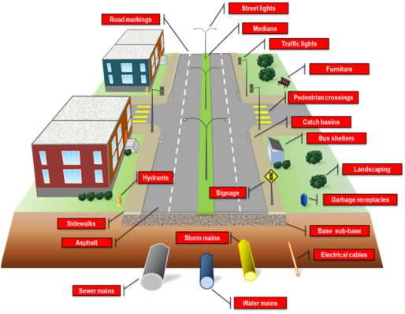
The Economic Principles of Land Value Taxation
Land value belongs to the community
Building value belongs to the owner
Land Value
Represents the presence of…
- Public infrastructure
- Public facilities & services
- Area amenities & desirability
- Accessibility
Building & Improvement Value
- Represents owners capital investment
Socially- created value
Privately-created
value
VS

Slide 5
Principle of Progressive Taxation
A tax tends to diminish its tax base.
What is in the public interest should be taxed less.
What is not desirable should be taxed more.
Job Growth
Capital investment
Land/Resource Consumption

Slide 6
The current property tax system does
just the opposite!
Taxing Capital investment more
&
Land/Resource consumption less
By taxing land and improvement values at the same rate, the bulk of a jurisdiction’s tax falls on building investments. The tax falls lightly on land-consuming uses where building investments are minimal.
The Results?
Urban Sprawl
• Devouring valuable resource lands
• Creating high household transportation costs
Land Price Inflation
• Incentivizing rent-seeking, i.e. land speculation and windfalls
• Driving high housing costs

Slide 7
What is in the public interest should be taxed less.
LVT taxes improvement assessments at a lower rate.
What is not desirable should be taxed more.
LVT taxes land assessments at a higher rate.
The equal rate tax should be replaced
by a two-rate tax.

Slide 8
COMPARISON OF TWO
PROPERTY TAX SYSTEMS
Method of Calculating Tax Bills for Individual Properties
Conventional Uniform Ad Valorem Tax
Total Value
Tax
Rate
Tax Bill
Two-rate Land Value Property Tax
Bldg. Value
Bldg.Tax
Rate
Land Value
Land Tax
Rate
Tax Bill

Slide 9
The two-rate LVT Ratio is expressed as the percentage of the total tax rate applied to land assessments
Example of an LVT tax rate structure during a phase-in period
Phase-in Year | Total Tax Rate | LVT Ratio | Land Tax Rate | Building Tax Rate
Year 1 | 21.00 | 55% | 24.03 | 19.66
Year 2 | (mill rate) | 60% | 27.14 | 18.09
Year 3 |  | 65% | 30.48 | 16.41
Year 4 |  | 70% | 34.10 | 14.61
Year 5 |  | 75% | 38.01 | 12.67
Proposed features of model LVT legislation:
• Local option
• Uniform application of tax rates
• Revenue neutral in first year

Slide 10
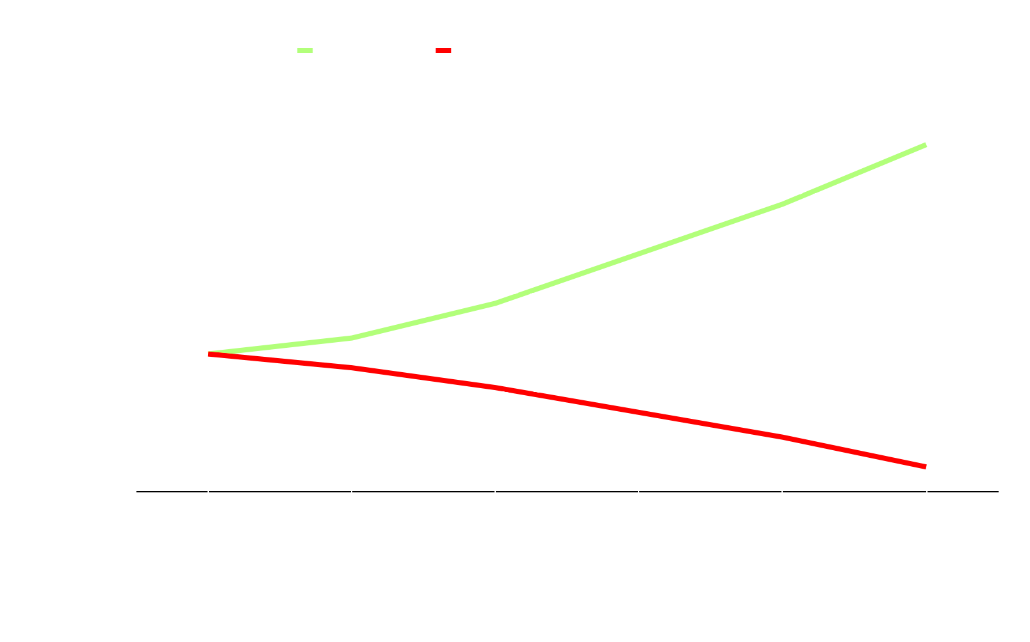
Why Can’t Measure 5 limitations coexist with LVT?
When the building tax rate is reduced, the land tax rate must rise to achieve revenue neutrality.
Conventional
Property Tax
Example
Two-Rate
Property Tax
Land Tax
Rate
26.76
Tax
Rate
13.89
Bldg. Tax
Rate
This rate exceeds M-5 limits.
8.92

Slide 11
Principle of Progressive Taxation
Oregon’s attempt to limit the growth in property tax assessments in 1993 resulted in unintended consequences
> Continuous revenue shortfalls
> Increasing disparity between market & taxable values
> Unequal treatment of taxpayers
A Study by the Northwest Economic Research Center at Portland State University found that by 2019 tax burdens had shifted from high value areas where land values grew rapidly – to low income communities where land values grew more slowly.
Link: pdxscholar.library.pdx.edu/nerc_pub/14

Slide 12
Consider Salem City parcels following 6 years of MAV* assessments:
Taxes on…
Multifamily apartments increased by 11.8%
Retail stores & offices increased by 5.0%
Downtown surface parking lots decreased by 4.2%
Downtown vacant lots decreased by 16.1%
…compared to a revenue neutral tax on RMV assessments.
These effects counteract the principle of progressive taxation and the objectives of Oregon’s Urban Growth Management Act.
* Maximum Assessed Value, under M-50 limitations (3 Percent annual increase).

Slide 13
What are the tax shift effects of a change back to RMV* assessments – with a Land Value Tax?
LVT taxes on Salem…
Multifamily apartments decrease by 28.0%
Retail stores & offices decrease by 5.0%
Downtown surface parking lots increase by 92.0%
Downtown vacant lots increase by 104.6%
…compared to a revenue neutral conventional tax on MAV taxable assessments.
These effects reinforce the principles of progressive taxation and the objectives of the state’s Urban Growth Management Act. 13
*Real Market Value - at a 75% LVT Ratio

Slide 14
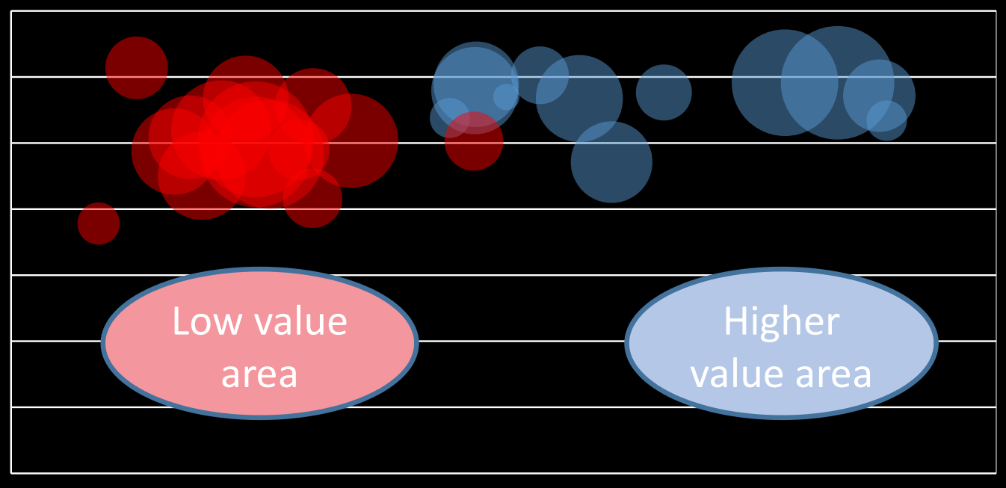
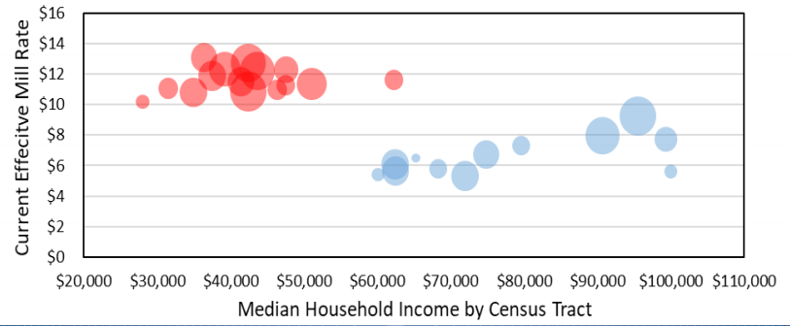
LVT results in a more balanced distribution of tax burden
…compared to the tax burden distribution under MAV assessments:

Slide 15
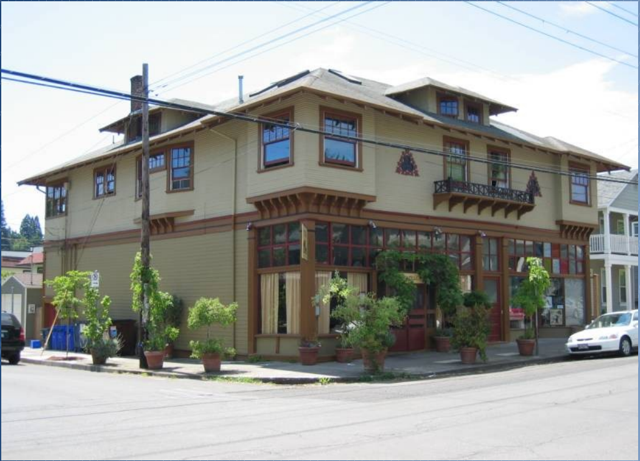
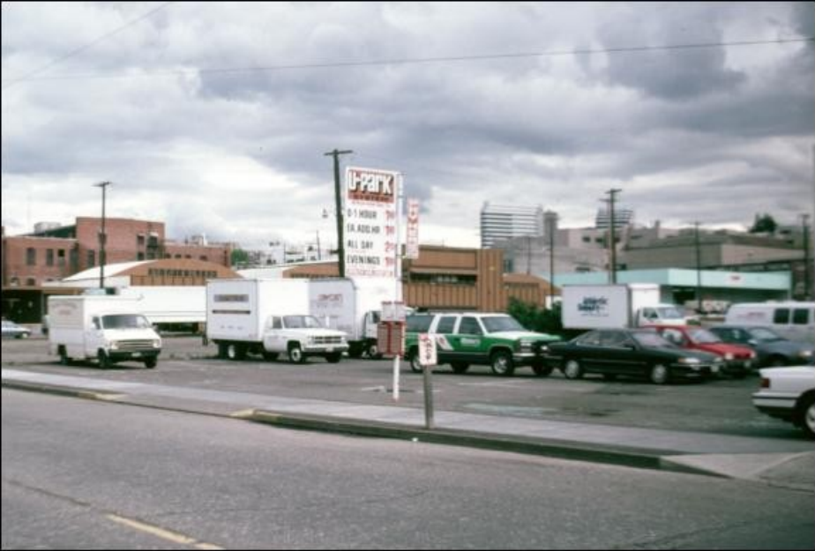
LVT incentivizes building investment
Generally…
Building-intensive uses will experience a decreased tax burden
Land-intensive uses will experience an increased tax burden
Low L-T-V Ratio
High L-T-V Ratio

Slide 16
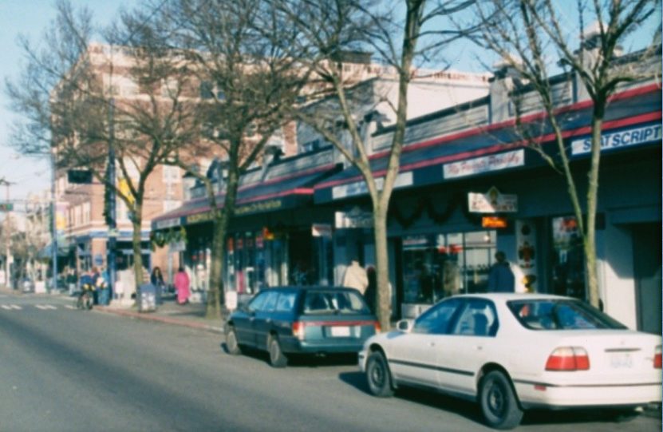
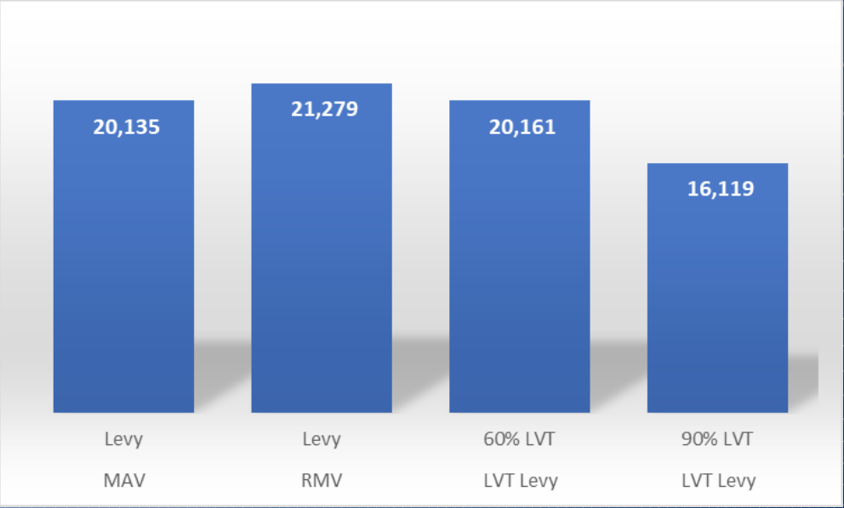
Illustration Of Tax Incentive Effects:
Inner Northeast Portland
Building-intensive uses are encouraged
by lower tax burdens
Land-intensive uses are discouraged
by higher tax burdens
The following slide pairs consist of photos of selected properties and the tax shift effects when changing from MAV to RMV to LVT:

Slide 17
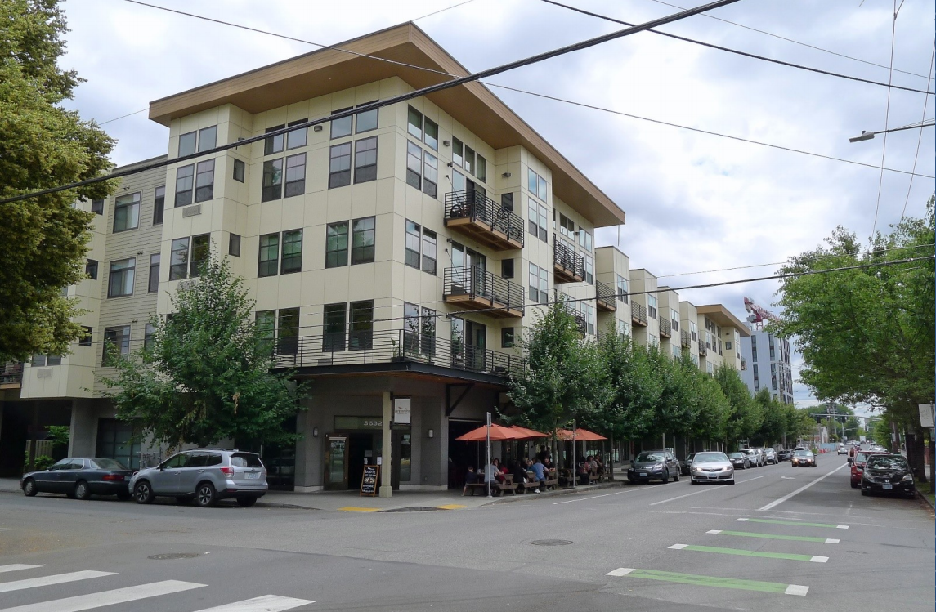
Year built: 2011 Multifamily Mid-Rise

Slide 18
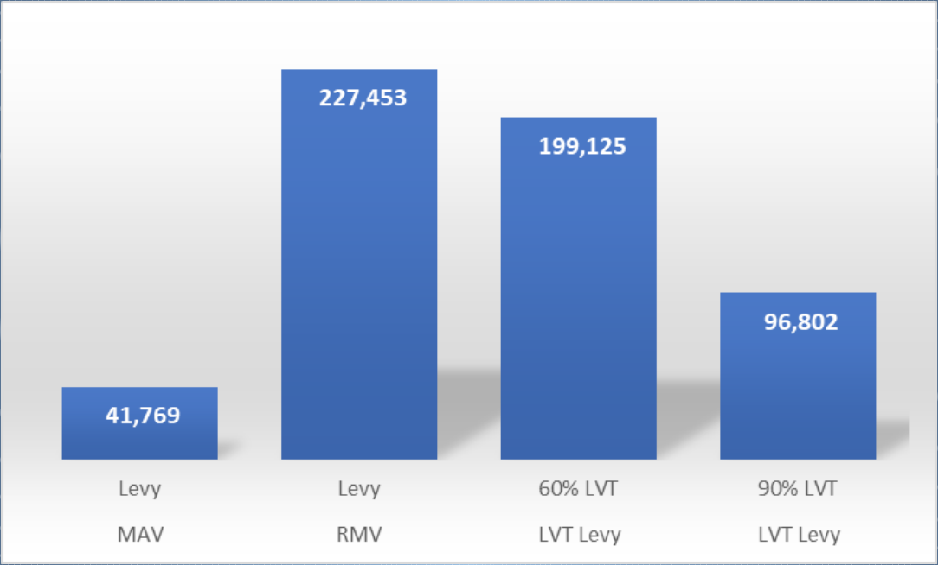
TAX SHIFT
MAV – RMV – 60% LVT – 90% LVT
Multifamily Mid-Rise
Year built: 2011
Real Market Value
Land = $2,052,670 Improv. = $19,346,290 L-T-V Ratio: .10

Slide 19
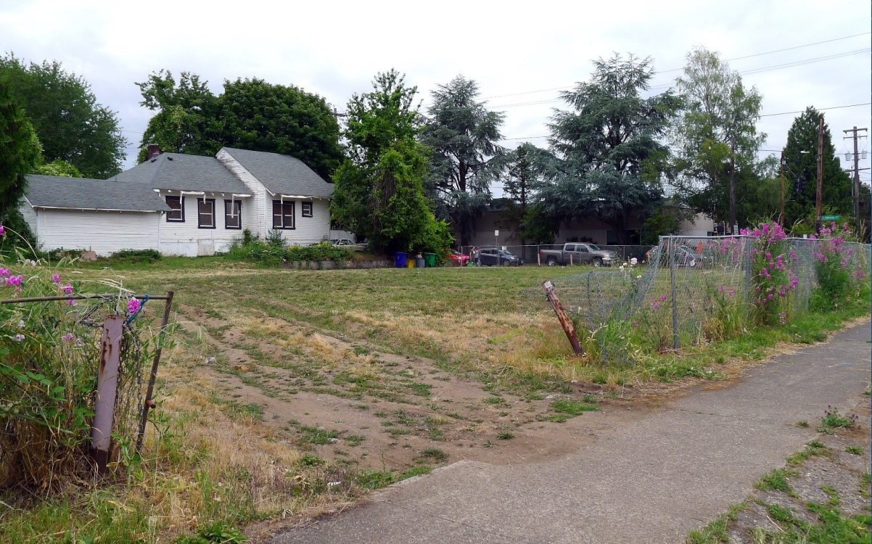
Vacant Lot

Slide 20
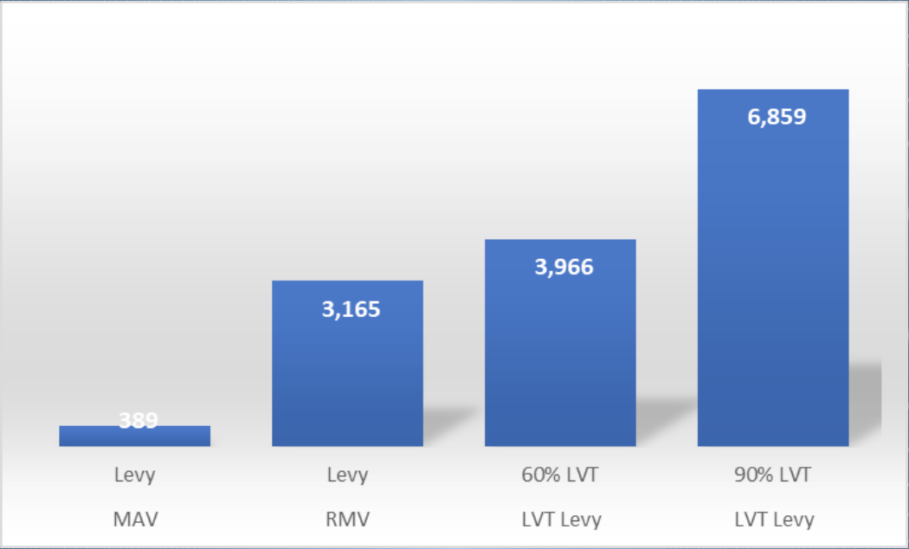
TAX SHIFT
MAV – RMV – 60% LVT – 90% LVT
Vacant Lot
Real Market Value
Land = $297,770 Improv. = $0
L-T-V Ratio: 1

Slide 21
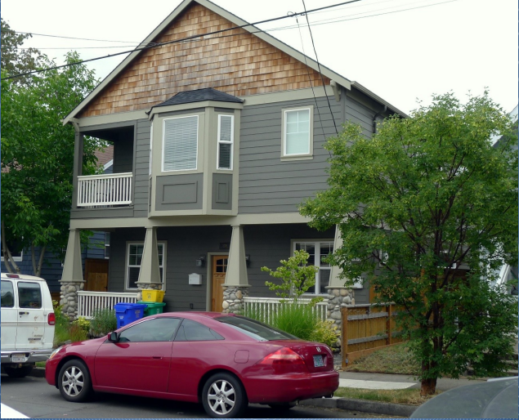
Year built: 2017 Single Family Infill

Slide 22
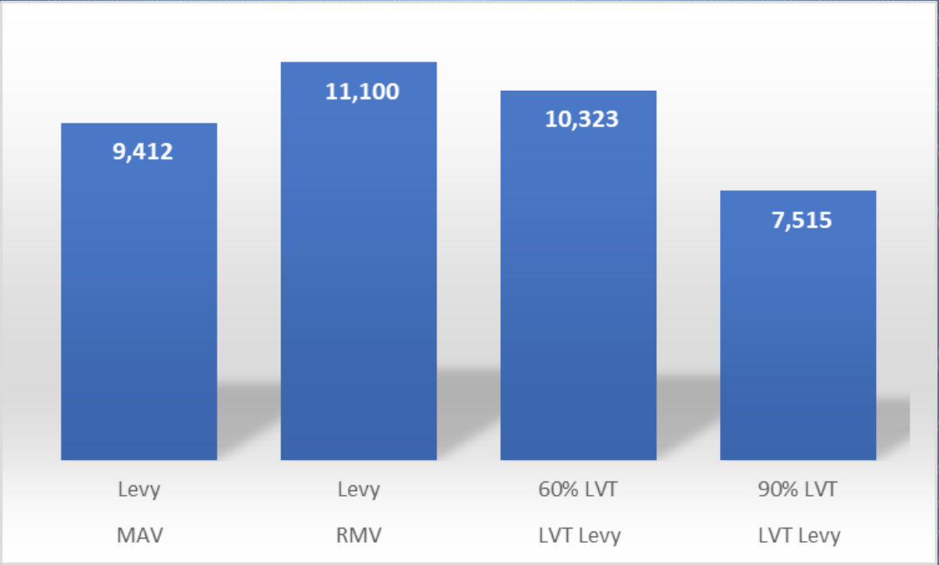
TAX SHIFT
MAV – RMV – 60% LVT – 90% LVT
Single Family Infill
Year built: 2017
Real Market Value
Land = $236,500 Improv. = $807,860 L-T-V Ratio: .23

Slide 23
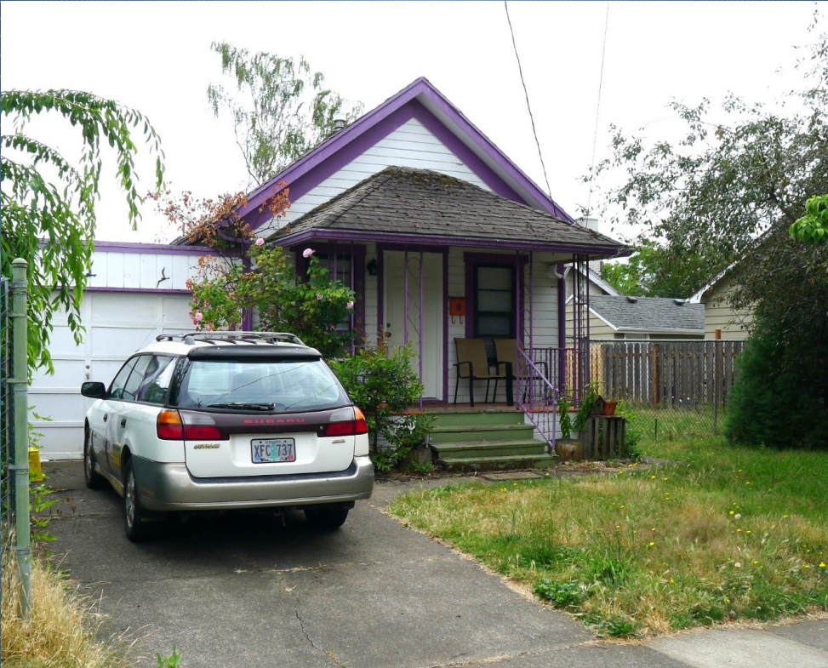
Year built: 1922 Single Family

Slide 24
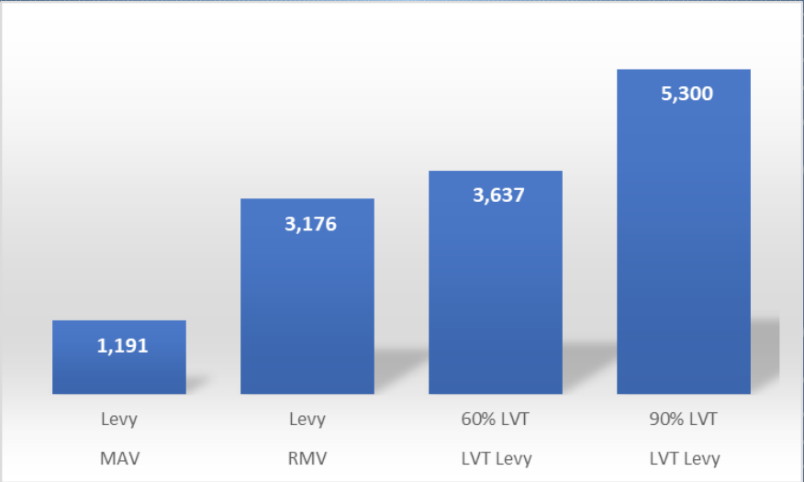
TAX SHIFT
MAV – RMV – 60% LVT – 90% LVT
Single Family
Year built: 1922
Real Market Value
Land = $221,500 Improv. = $77,370 L-T-V Ratio: .74

Slide 25
Key Provisions of a Resolution Authorizing a Local-Option Land Value Tax
A city or county may adopt the LVT alternative
Land & Improvements are taxed at differential rates
LVT is exempt from Measures 5 & 50 limitations
RMV assessments are restored, replacing MAV
Amendment is subject to statewide voter approval

Slide 26
Key Provisions of a Study bill examining feasibility of LVT
The Legislative Revenue Office will conduct a study of LVT, to include:
Examination of tax burden effects changing from taxation under Measures 5 & 50 limitations to taxation under LVT.
Simulation model comparisons using MAV and revenue neutral RMV assessments.
Examine comparative economic incentive effects in urban and rural jurisdictions.
Examine incentive effects in jurisdictions utilizing rural enterprise zones.
Examine possible tax burden relief measures for hardship cases.

Slide 27
What have LVT cities shown us?
Restore fairness and efficiency to the property tax system.
More stable than other taxes: sales, income; and moderates real estate boom–bust cycles.
Broaden the tax base: increases owner-occupancy, business growth.
Self-perpetuating finance: as building intensity increases and up-zoning occurs, land values rise, then local government capture more value to invest in infrastructure.

Slide 28
Thank you!
If you have any questions or comments please feel free to reach out to us via our website or social media pages.
Website: CommonGroundORWA.org
Facebook: @CommonGroundORWA
Twitter: @CG_OR_WA
Instagram: CommonGroundORWA

